Slide 1

An On-Device Face Verification App for Android
Shaheera Uqaili, Pritesh Soni
HCML- Project

Slide 2

Agenda
An On-Device Face Verification App for Android
System Overview
Benefits
Key technical aspects
User work-flow
Application Interface
Current Limitations
HCML- Project

Slide 3
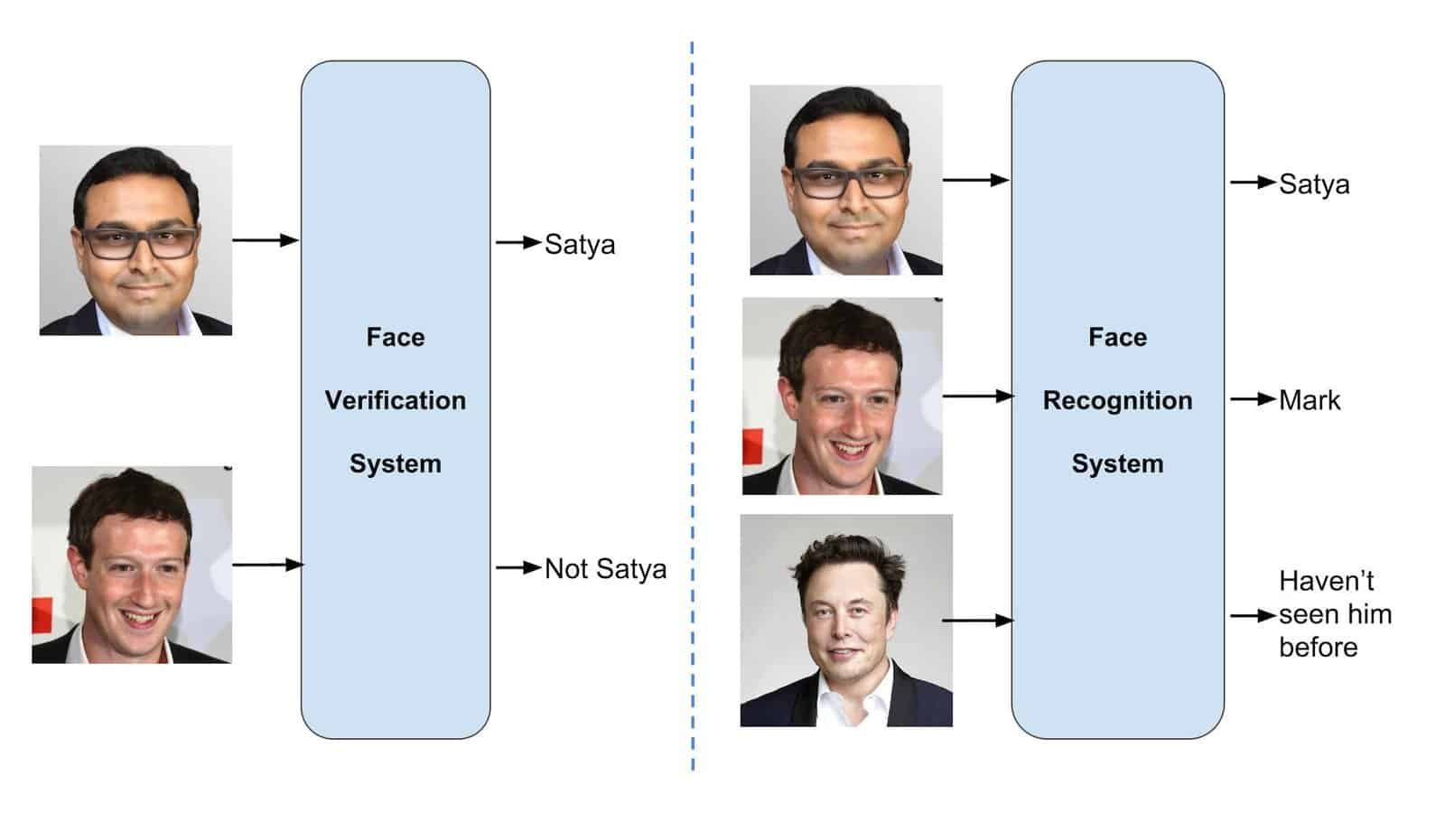
System Overview
An On-Device Face Verification App for Android
Main Features
Use Cases
The app offers essential capabilities for secure face authentication, providing seamless user access with enhanced verification accuracy.
This technology is applicable across multiple sectors, including banking, security, and mobile applications for identity verification.
HCML- Project
HCML- Project

Slide 4
An On-Device Face Verification App for Android
Benefits
Connectivity
Security
Privacy
HCML- Project

Slide 5
Key technical aspects
An On-Device Face Verification App for Android
Image Pre-processing
Recognition Model
Template-based enrolment using MTCNN, a neural network which detects faces and facial landmarks on images, and then pre-processes them through alignment and cropping using MTCNN
Using MobileFaceNets, an efficient CNN model tailored for high-accuracy real-time face verification on mobile and embedded devices, a deep neural network used for extracting features from an image of a person’s face.
HCML- Project

Slide 6

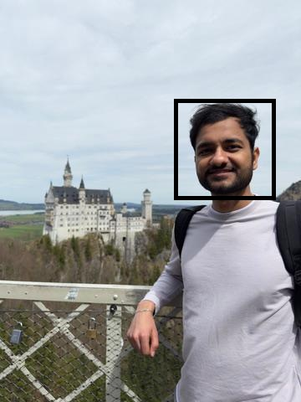

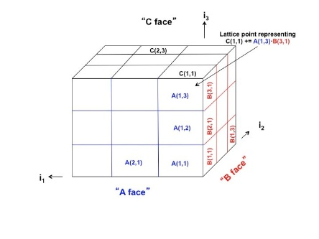
Model Workflow
An On-Device Face Verification App for Android
Success
Cosine Similarity (> 0.3)
Failed
Raw Image
Face Detection & Alignment
Cropped Image
Feature Embeddings
Decision

Slide 7
User work-flow
An On-Device Face Verification App for Android
Registration
Login
The user is required to provide its name and take pictures of their faces with the device’s camera. The unique ID would be generated automatically and embeddings of the taken picture. The system stores user metadata locally on the device.
Once again, embeddings are generated during the login and compared with stored embeddings using cosine similarity.
we have used a threshold of 0.3 of cosine similarity to verify if the user is enrolled in the application.
HCML- Project

Slide 8
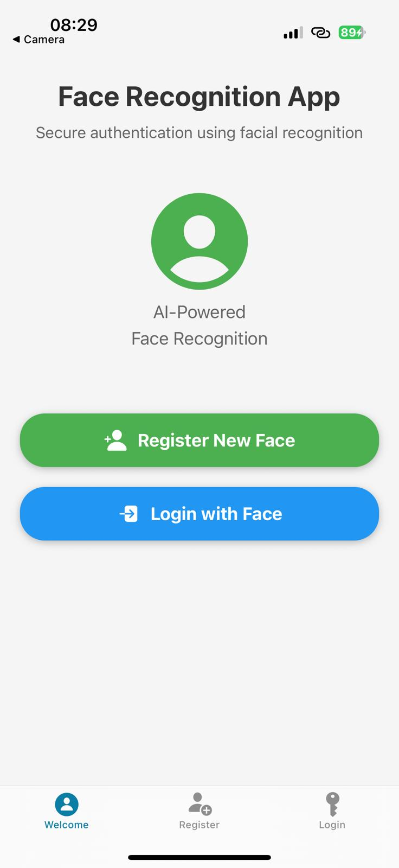
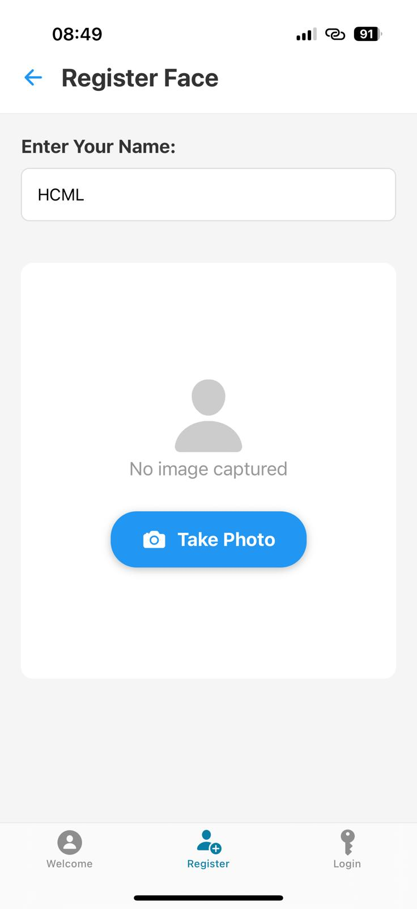
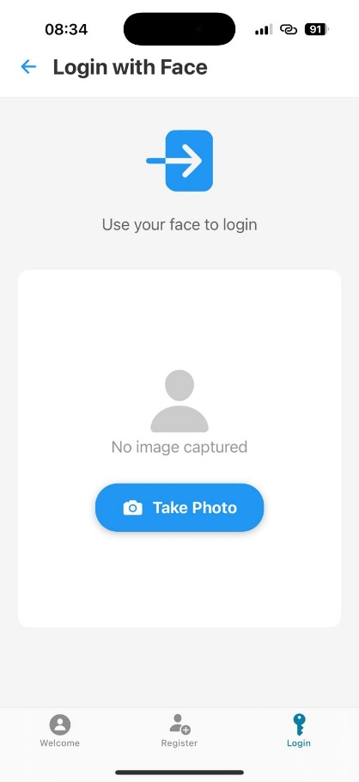
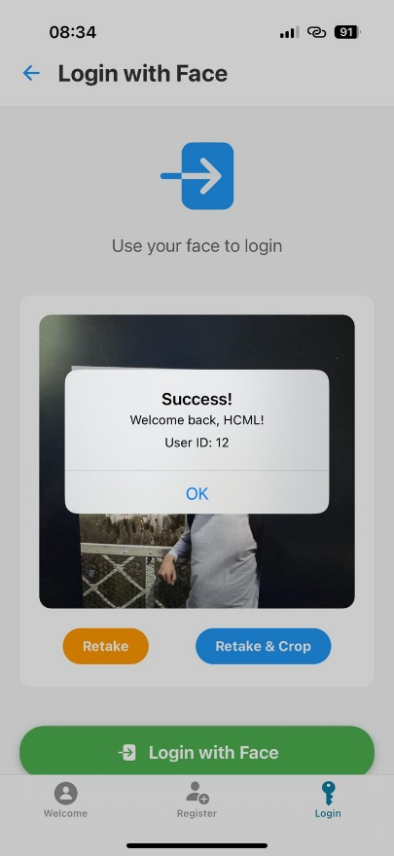
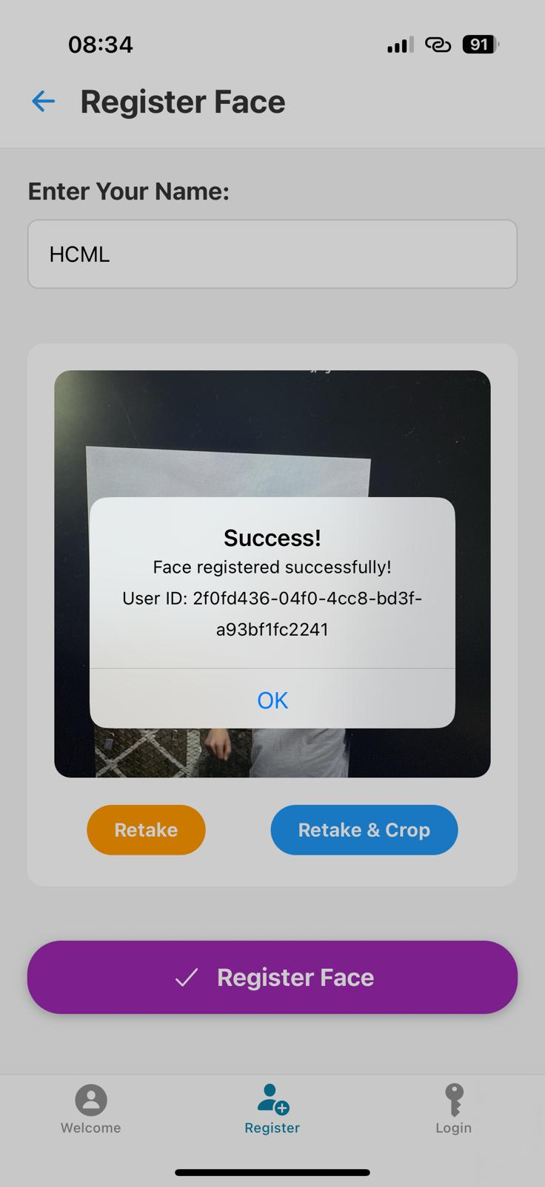
Application
An On-Device Face Verification App for Android

Slide 9

Current Limitation & Future Work
An On-Device Face Verification App for Android
Improvements
Convert and Integrate the application from Cloud-based to On-Device.
Make sure all the processing of images are On-device.
Add features for Multi-modal Biometrics for security.
Robust Spoofing Countermeasures:To verify the biometrics presented are of live person.
Limitations
Currently the Mobile Application is not truly On-device.
We have used a backend (Flask) to run the application
A cloud-based server for processing of image.
HCML- Project

Slide 10
Questions?
An On-Device Face Verification App for Android
HCML- Project

